Slide 1
深度學習智慧應用 Lab 2: YOLO
Network Optimization Lab (NOL)
Department of Computer Science
National Chiao Tung University

Slide 2
Outline
Introduction
YOLO v1
YOLO v2
YOLO v3
Lab 3

Slide 3
Introduction

Slide 4
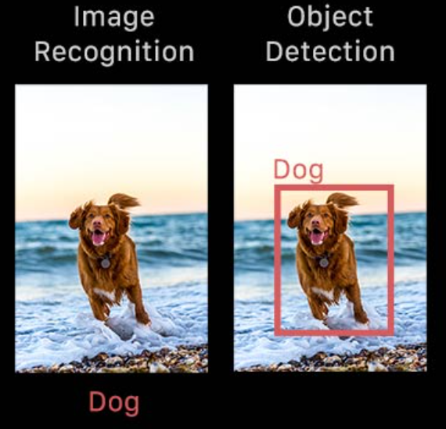
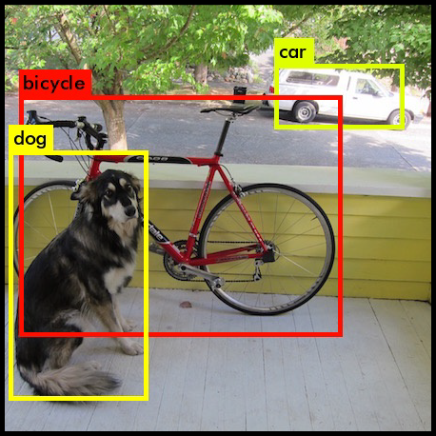
What is Object Detection
Object detection is a computer vision technique that allows us to identify and locate objects in an image or video.

Slide 5
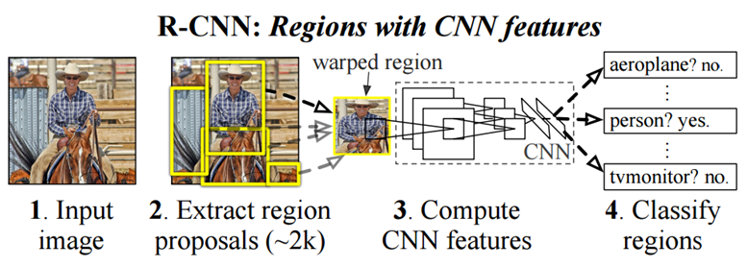
Method
Slide window
a rectangular region of fixed width and height that “slides” across an image
Two stages (R-CNN, Fast R-CNN, Faster R-CNN, …)
First, the model proposes a set of regions of interest by selective search or regional proposal network
Then a classifier processes the extracted regions using their features.

Slide 6
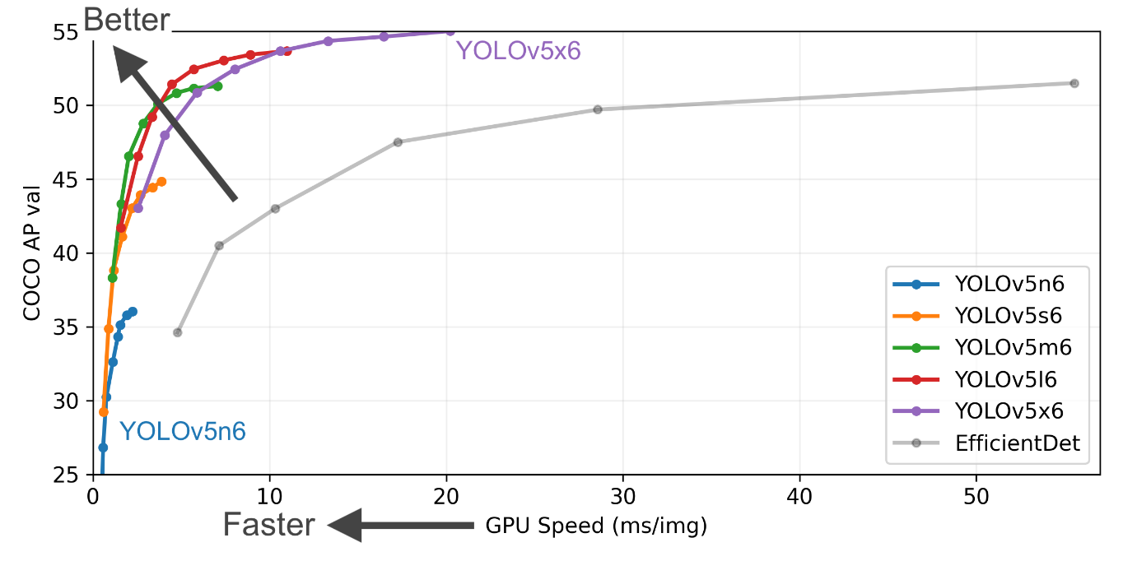
Method
One stage (You Only Look Once)
YOLO v1, YOLO v2, YOLO V3, ……
A single neural network directly predicts bounding boxes and class probabilities from full images in one evaluation.
ultralytics/yolov5: YOLOv5 🚀 in PyTorch > ONNX > CoreML > TFLite

Slide 7
YOLO v1
Redmon, J., Divvala, S., Girshick, R., & Farhadi, A. (2016). You only look once: Unified, real-time object detection. In Proceedings of the IEEE conference on computer vision and pattern recognition (pp. 779-788).

Slide 8
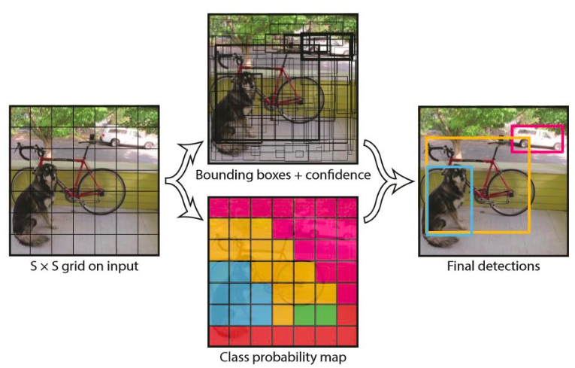
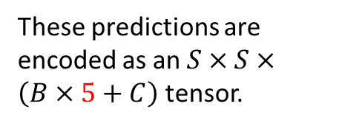
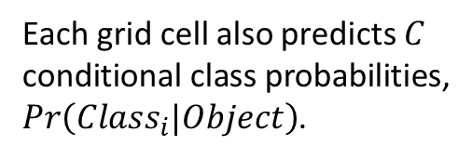
Detection
These predictions are encoded as an $S×S×\left(B×5+C\right)$ tensor.
Each grid cell also predicts $C$ conditional class probabilities,
$Pr\left({Class}_{i}|Object\right)$.
Notes:
(1) 将原图划分为SxS的网格。如果一个目标的中心落入某个格子，这个格子就负责检测该目标。
(2) 每个网格要预测B个bounding boxes，以及C个类别概率Pr(classi|object)。这里解释一下，C是网络分类总数，由训练时决定。在YOLO中，每个格子只有一个C类别，即相当于忽略了B个bounding boxes，每个格子只判断一次类别，这样做非常简单粗暴。
(3)还要附带预测一个confidence值
如果有目标落中心在格子里Pr(Object)=1；否则Pr(Object)=0。 第二项是预测的bounding box和实际的ground truth之间的IOU。
(4) 由于输入图像被分为SxS网格，每个网格包括5个预测量：(x, y, w, h, confidence)和一个C类，所以网络输出是SxSx(5xB+C)大小
(5) 在检测目标的时候，每个网格预测的类别条件概率和bounding box预测的confidence信息相乘，就得到每个bounding box的class-specific confidence score:
最后设置一个阈值与class-specific confidence score对比，过滤掉score低于阈值的boxes，然后对score高于阈值的boxes进行非极大值抑制(NMS, non-maximum suppression)后得到最终的检测框体。

Slide 9
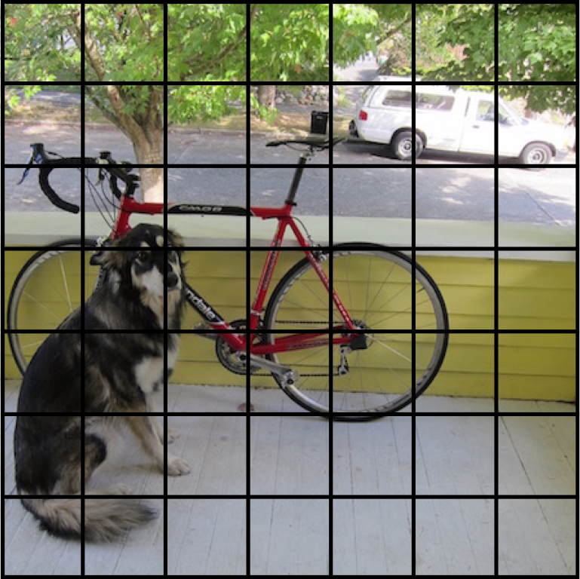
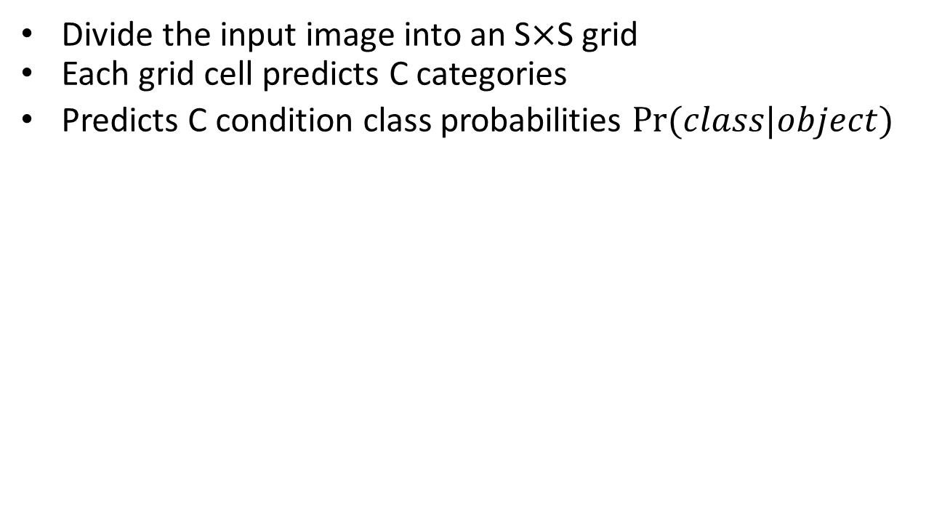
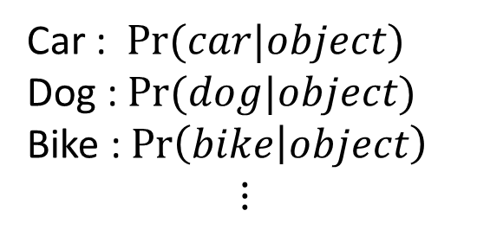
Grid Cell Classification
Divide the input image into an S$×$S grid
Each grid cell predicts C categories
Predicts C condition class probabilities $Pr⁡(class|object)$
Car : $Pr⁡(car|object)$
Dog : $Pr⁡(dog|object)$
Bike : $\operatorname{Pr}\left(bike | object\right)$ $$⋮$$

Slide 10
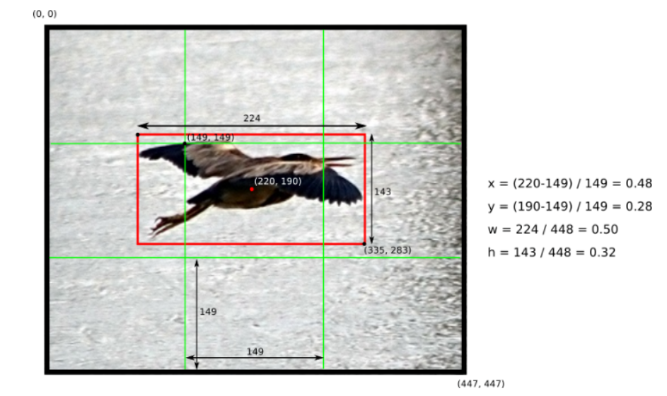
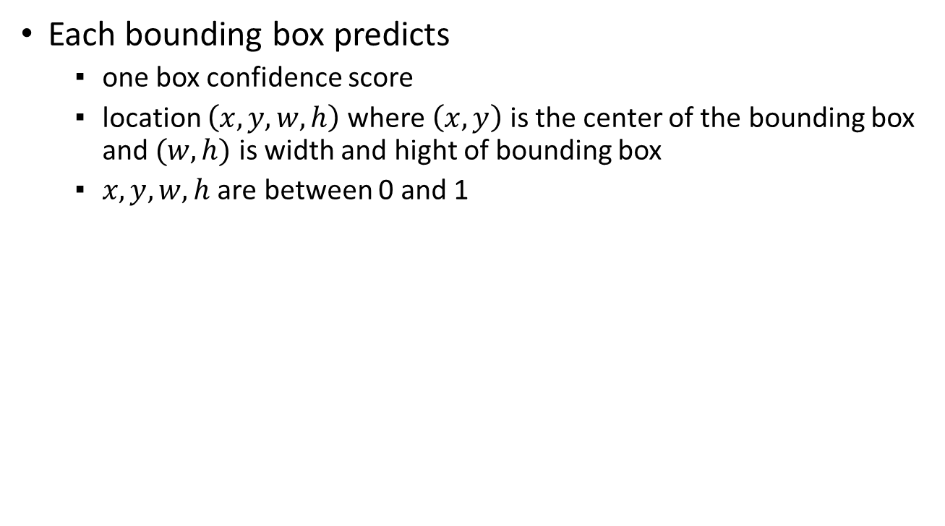
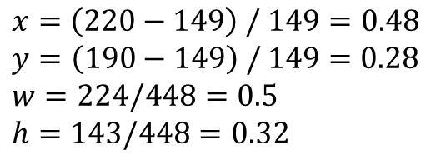
Bounding Box
Each bounding box predicts
one box confidence score
location $\left(x,y,w,h\right)$where $\left(x,y\right)$ is the center of the bounding box and $(w,h)$ is width and hight of bounding box
$x,y,w,h$ are between 0 and 1
$x=\left(220−149\right) /$ $149=0.48$
$y=\left(190−149\right) /$ $149=0.28$
$$w=224/448=0.5$$
$$h=143/448=0.32$$
Notes:
以此圖為例，圖片大小為448x448，切成3x3，所以每個網格大小為149x149
中間這個網格所預測出的bounding box中心點在(220,190)這是對整張圖片而言，我們要做出對中間這個網格而言的座標

Slide 11
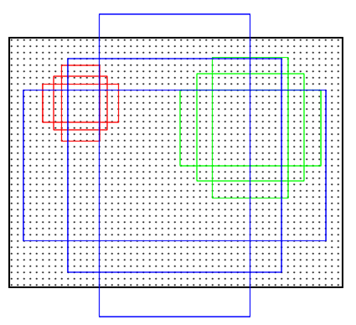
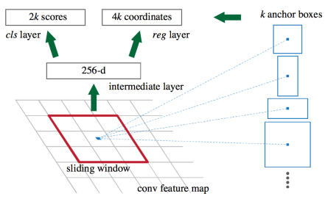
Anchor Boxes

Slide 12
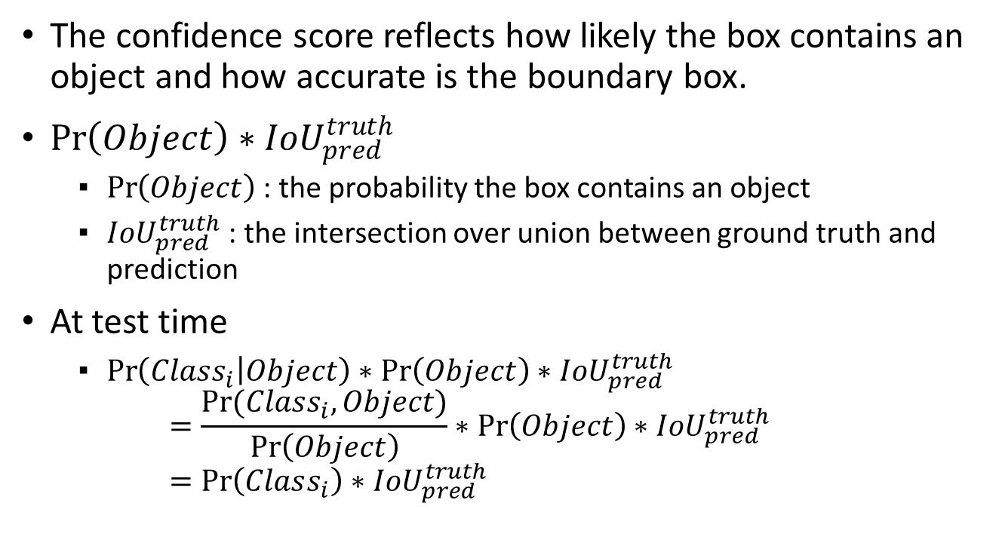
Confidence Score
The confidence score reflects how likely the box contains an object and how accurate is the boundary box.
$\operatorname{Pr}\left(Object\right)∗{IoU}_{pred}^{truth}$
$\operatorname{Pr}\left(Object\right)$ : the probability the box contains an object
${IoU}_{pred}^{truth}$ : the intersection over union between ground truth and prediction
At test time
$\operatorname{Pr}\left(Class_{i} | Object\right)∗\operatorname{Pr}\left(Object\right)∗{IoU}_{pred}^{truth}$ $=\frac{\operatorname{Pr}{(Class_{i}, Object)}}{\operatorname{Pr}\left(Object\right)}∗\operatorname{Pr}\left(Object\right)∗{IoU}_{pred}^{truth}$ $=\operatorname{Pr}\left(Class_{i}\right)∗{IoU}_{pred}^{truth}$
Notes:
confidence則是用來表示這個物件是否為一個物件的信心程度(confidence score)
Confidence score 為bounding box是否有物體及其範圍準確度
Pr(object)是bb有物體的機率，iou等等會說明是什麼，主要是衡量範圍
在test階段會出現的confidence score是將grid cell的機率值乘上bb的confidence score，因為pr(class|ob)是條件機率

Slide 13
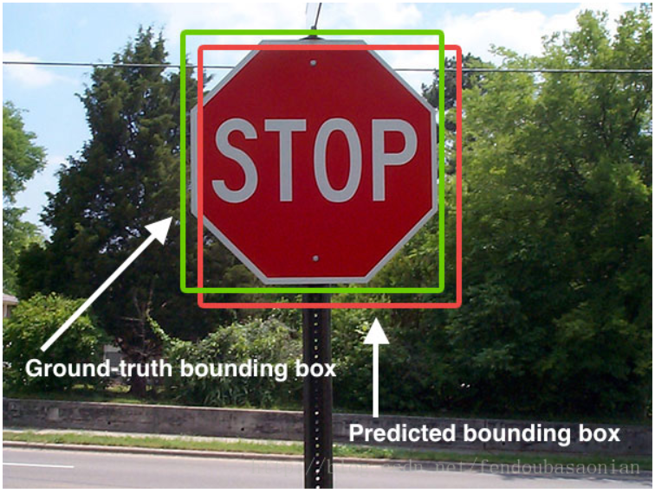
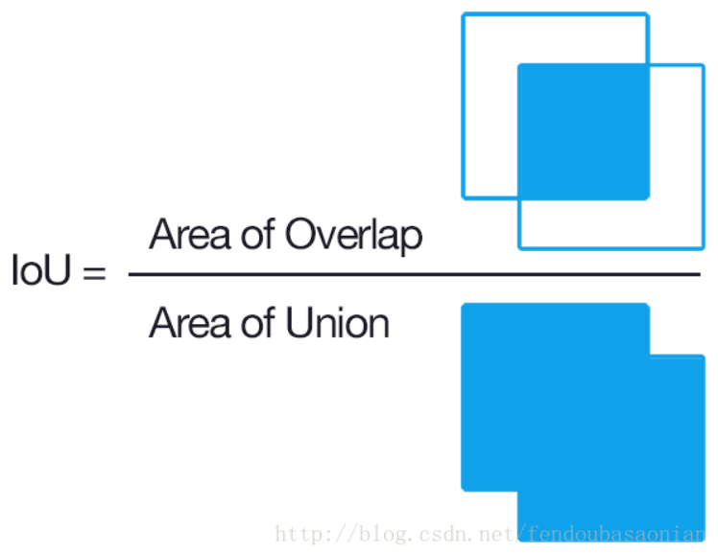
IoU (Intersection over Union)
Input : the bounding box of the ground truth and predict
Output : the number between 0 and 1

Slide 14
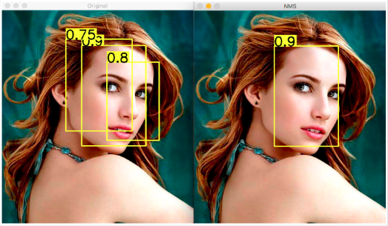
Non-max suppression
Notes:
以目标检测为例：目标检测的过程中在同一目标的位置上会产生大量的候选框，这些候选框相互之间可能会有重叠，此时我们需要利用非极大值抑制找到最佳的目标边界框，消除冗余的边界框

Slide 15
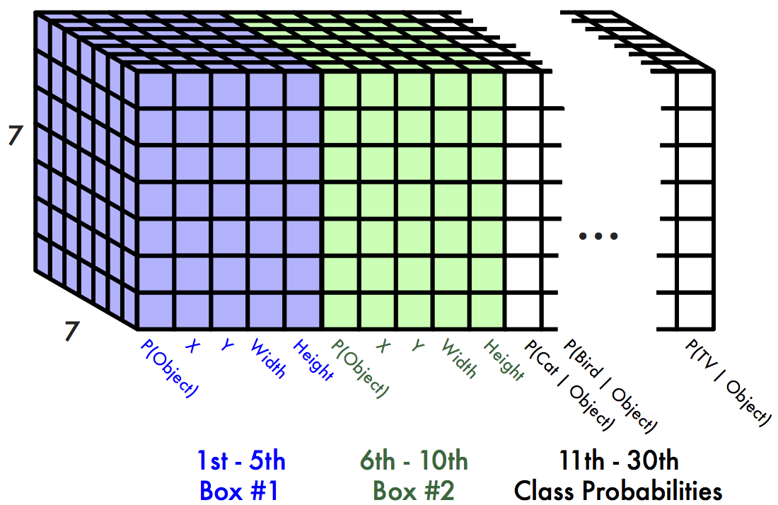
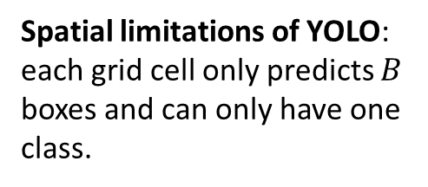
Prediction Layer (Output)
Each cell predicts
For each bounding box
4 coordinates (x, y, w, h)
1 confidence value
Some number of class probabilities
For Pascal VOC
7x7 grid
2 bounding boxes per cell
20 classes
7 x 7 x (2 x 5 + 20) = 1470 outputs
Spatial limitations of YOLO: each grid cell only predicts $B$ boxes and can only have one class.

Slide 16
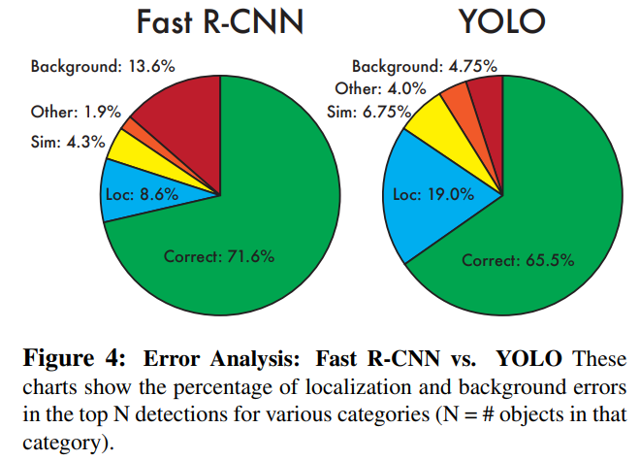
Pros and Cons
Pros
Fast. Good for real-time processing
YOLO is more generalized.
YOLO demonstrates fewer false positives in background areas.
Cons
Because a grid cell can only detect one object, it is not good for very close objects or small groups.
Because the prediction of the bounding box is learned, it is not good for predicting new objects or objects with unusual proportions.
Localization error is higher
Recall is lower
Notes:
優 :
1.
2.可推廣到其他方面的圖片，例如美術作品。
3. 因為是看整張圖，所以對於背景的誤判率較低，也就是把背景當作物體
缺:
1.因為一個grid cell只能偵測一個物體，所以對太接近或是小群體的偵測效果不好
2.因為bounding box是經由學習，所以對於新物體或是比例太奇怪的物體效果也是不好
3.位置的定位錯誤較嚴重
4.recall : 正確被檢所占所有應該被檢所的比率，例如有個物體應該要被檢測到但model卻沒有檢測到

Slide 17
YOLO v2
Redmon, J., & Farhadi, A. (2017). YOLO9000: better, faster, stronger. In Proceedings of the IEEE conference on computer vision and pattern recognition (pp. 7263-7271).

Slide 18
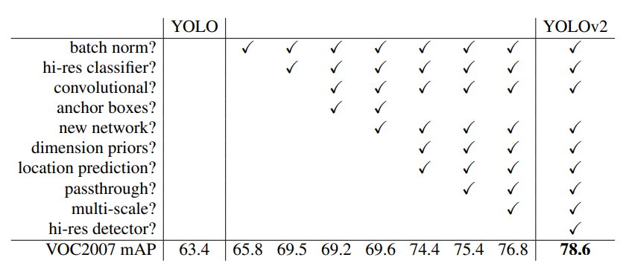
In YOLO v2
Batch normalization
New network
High resolution classifier
Using Anchor Boxes
Direct location prediction
Fine-grained features
Multi-Scale Training

Slide 19
YOLO v3
Redmon, J., & Farhadi, A. (2018). Yolov3: An incremental improvement. arXiv preprint arXiv:1804.02767.

Slide 20
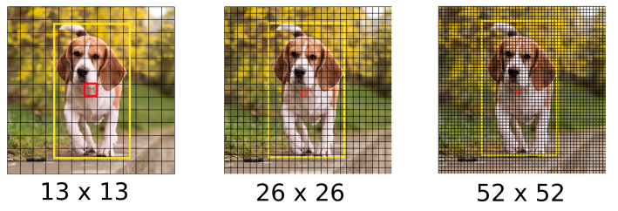
Prediction across scales
Makes prediction across 3 different scales
Input : 416x416
Detection on scales 13x13, 26x26, 52x52

Slide 21
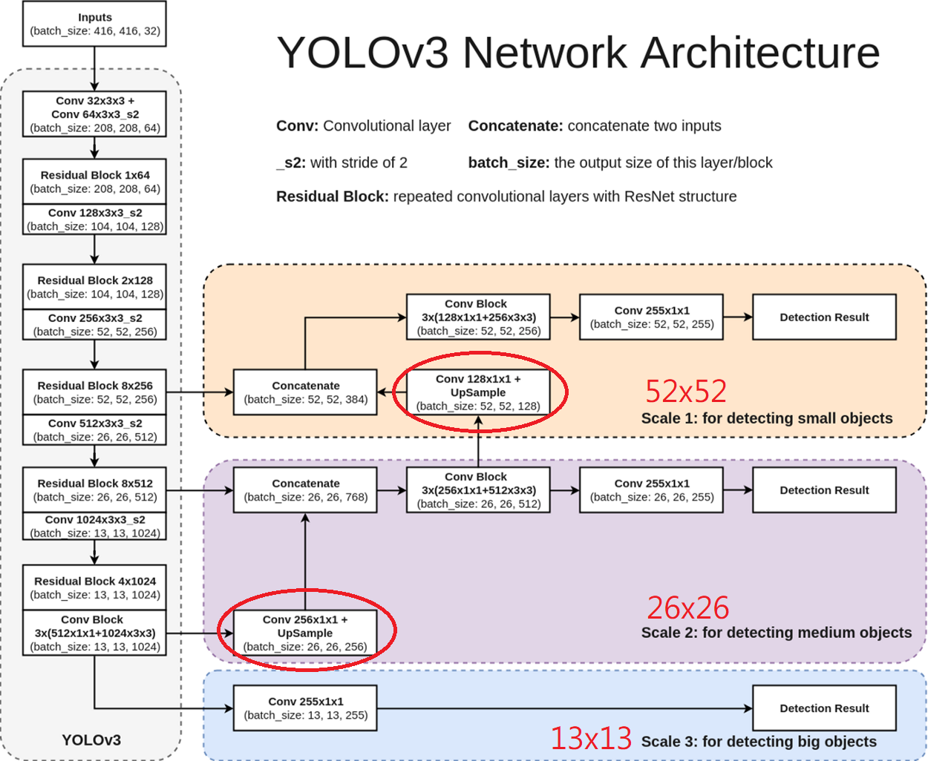

Slide 22

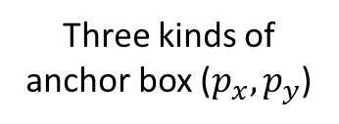
Bounding Box Predictions
Three kinds of anchor box ($p_{x},p_{y}$)
YOLO v2
Use dimension cluster to generate the anchor boxes
YOLO v3
Using 3 different scales 1:1, 1:2, 2:1
13x13x3
+ 26x26x3
+ 52x52x3
= 10647 boxes
13x13x5
= 845 boxes
416 x 416

Slide 23
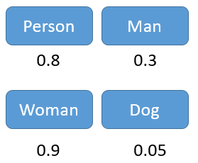

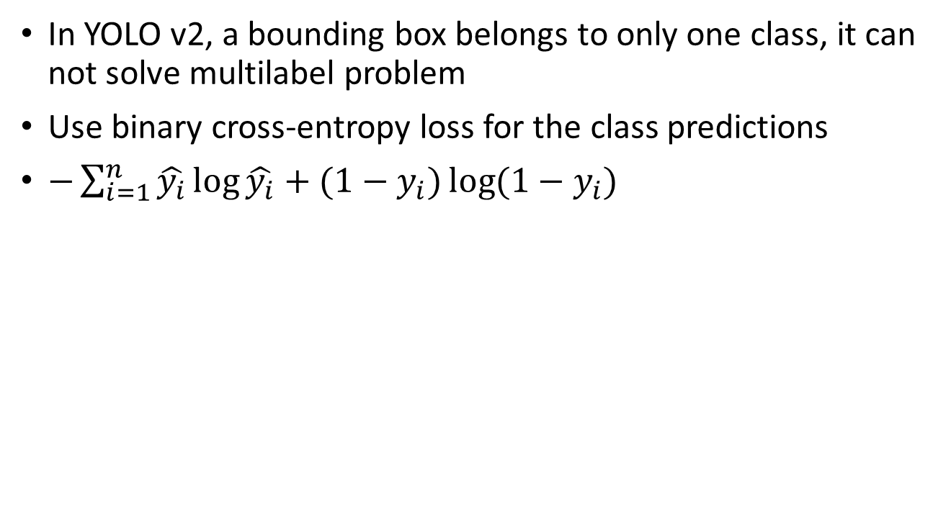
Class Predictions
In YOLO v2, a bounding box belongs to only one class, it can not solve multilabel problem
Use binary cross-entropy loss for the class predictions
$−\sum_{i=1}^{n}{\hat{y_{i}}\log{\hat{y_{i}}}+(1−y_{i})\log{(1−y_{i})}}$

Slide 24
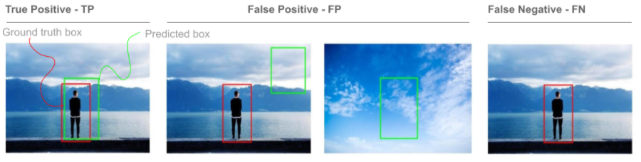
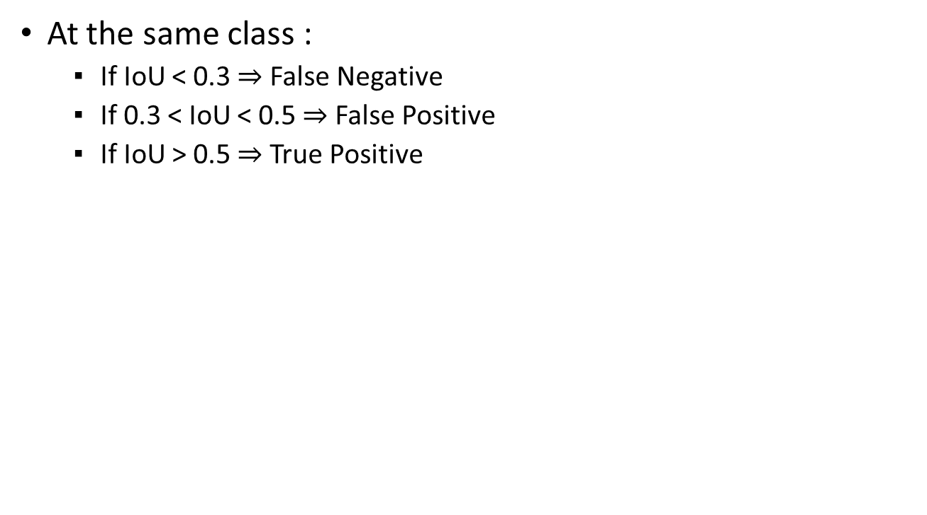
Metric
At the same class :
If IoU < 0.3 $⇒$ False Negative
If 0.3 < IoU < 0.5 $⇒$ False Positive
If IoU > 0.5 $⇒$ True Positive

Slide 25
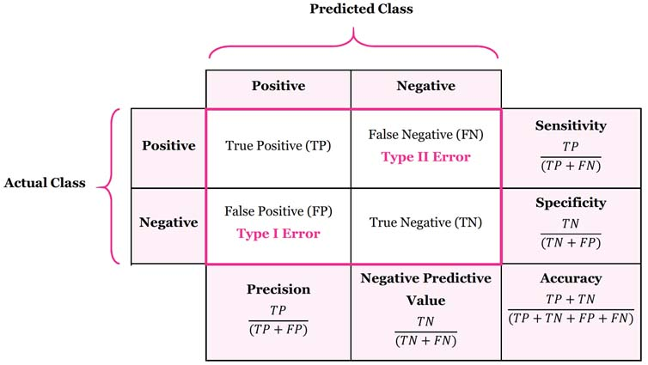
Metric
Accuracy
Precision
Recall

Slide 26
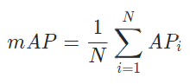
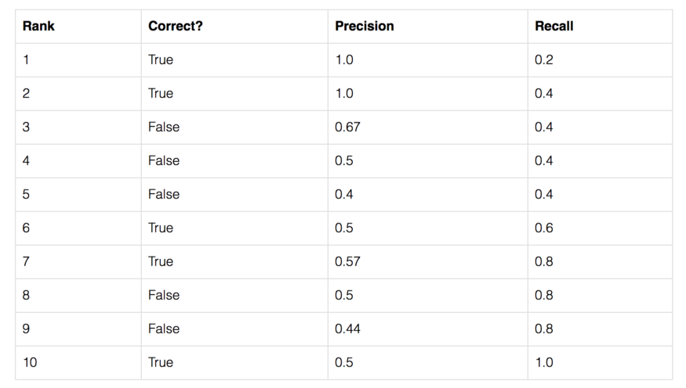
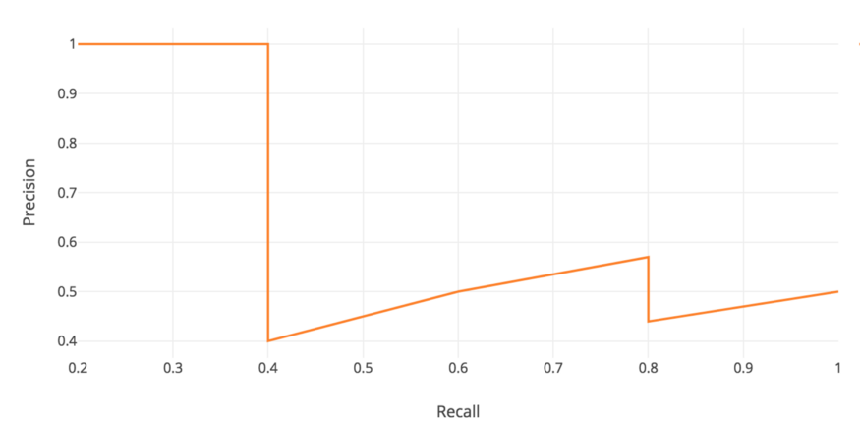
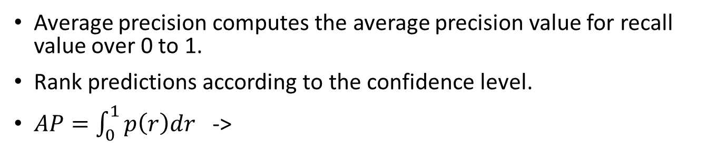
mAP
Average precision computes the average precision value for recall value over 0 to 1.
Rank predictions according to the confidence level.
$AP=\int_{0}^{1}{p\left(r\right)dr}$ ->
https://medium.com/@jonathan_hui/map-mean-average-precision-for-object-detection-45c121a31173

Slide 27
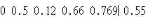
Metric
Metric code (you need to use it for calculating mAP) – Github: https://github.com/sssrabit/DLAPP_Lab3
Save your prediction result to “.txt” file and the format is : Please normalize x,y,w,h and each value split in space, each bounding box split in enter
Different image save different txt file
If you find any question or bug, please let me know.
class
x,y,w,h
confidence

Slide 28
Augmentation

Slide 29
What is Image Augmentation?
A technique to create new training images by modifying existing ones.
Increases dataset diversity, helping models learn better.

Slide 30
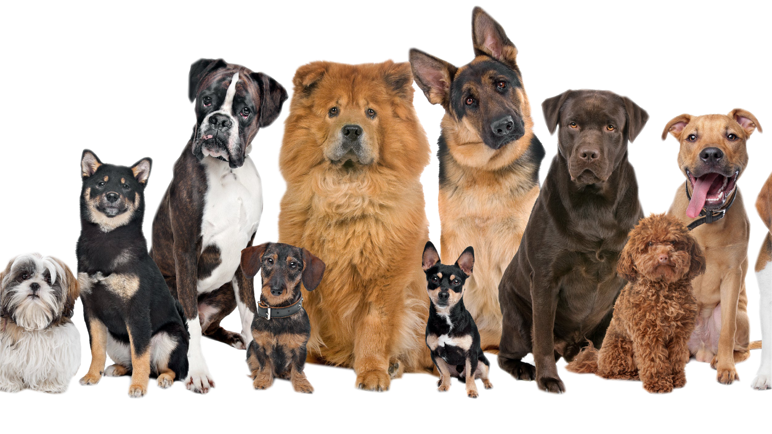
What is Image Augmentation?

Slide 31
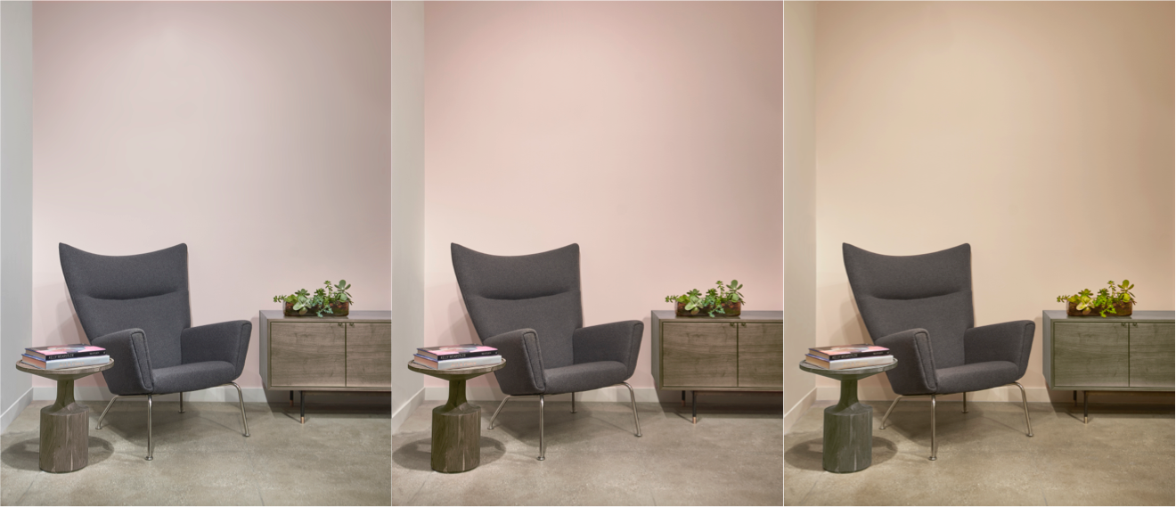
Real-Life Examples of Augmentation
Object detection in different lighting
https://www.purewow.com/home/how-lighting-changes-room

Slide 32

Real-Life Examples of Augmentation
Face recognition across angles
https://xailient.com/blog/the-8-impressive-benefits-of-edge-face-recognition/

Slide 33
Why Use Image Augmentation?
Benefits
Reduces overfitting
Enhances model accuracy
Creates variety in limited datasets

Slide 34
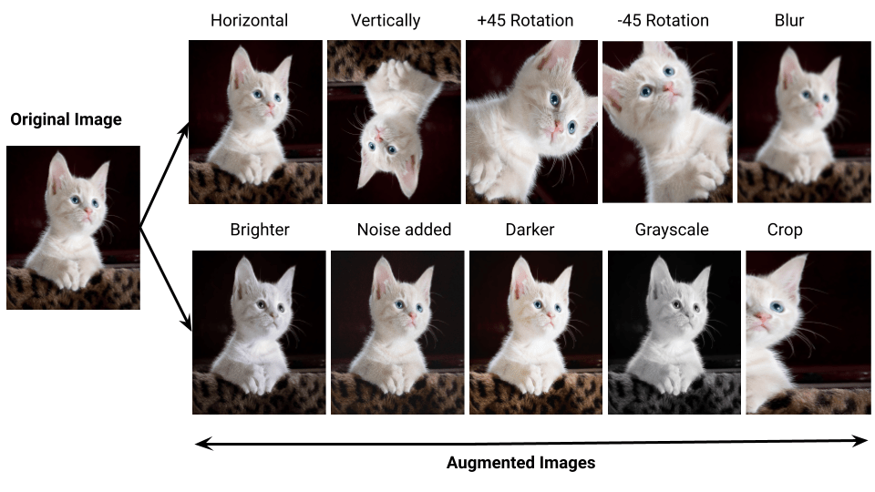
Types of Image Augmentation
Key Types:Rotation
Flipping
Scaling
Color adjustment
https://ubiai.tools/what-are-the-advantages-anddisadvantages-of-data-augmentation-2023-update/

Slide 35
Summary
Image augmentation = more varied, better training data.

Slide 36
Lab 2

Slide 37
Lab2
Data Label
Trainning
Performance
Demo

Slide 38
Data Label
Labeling tool
Roboflow => https://app.roboflow.com/

Slide 39
Trainning and inference
Ultralytics
Train
Predict

Slide 40
Improvement
Hand in a paper about how you improvement

Slide 41
Demo
There will 35 images for each team to predict, every single image is 1 point, the final score will be the number of image you success to predict.

Slide 42
Grading
Data Label (10%)
Successfully executable (40%)
Improvement(25%)
Performance(35%)

Slide 43
Deadline
Data Label
On 11/18 23:59
Report
On 11/25 23:59
Demo
On 11/26 after TA’s lecture
Each group needs at least 1 member to demonstrate
Late Submission
10% less per day (e.g. 90->81->73)
If you have any problems about submission & demo please contact TAs before deadline

Slide 44
TAs
frank96270.cs12@nycu.edu.tw
jasonzzz402.cs13@nycu.edu.tw

